Slide 1
A Randomized Trial of Liraglutide for High-Risk Heart Failure Patients with Reduced Ejection Fraction (FIGHT)
Embargoed Until 3:45 p.m. ET, Sunday, Nov. 8, 2015
Kenneth B. Margulies, M.D.
On behalf of the
NHLBI Heart Failure Clinical Research Network
Notes:
On behalf of the NHLBI Heart Failure Clinical Research Network, I’m happy to present the FIGHT Trial, A Randomized Trial of Liraglutide for High-Risk Heart Failure Patients with Reduced Ejection Fraction

Slide 2
Background: HF Bioenergetics
The heart consumes more energy per gram than any organ and is continuously dependent on ATP synthesis
As the heart fails, fatty acid metabolism is down-regulated, and ATP synthesis is more dependent on glucose
In advanced heart failure, the myocardium also becomes insulin-resistant, which limits glucose uptake and further limits ATP production
No current heart failure therapy directly targets these metabolic derangements
Notes:
The heart consumes more energy per gram than any organ and is continuously dependent on ATP synthesis
As the heart fails, fatty acid metabolism is downregulated, and ATP synthesis is more dependent on glucose
In advanced heart failure, the myocardium also becomes insulin-resistant, which limits glucose uptake and further limits ATP production
No current heart failure therapy directly targets these metabolic derangements

Slide 3
GLP-1 improves glucose utilization
Glucagon-like peptide-1 (GLP-1) augments glucose uptake by increasing insulin secretion and insulin sensitivity
In a pilot study of 12 patients with advanced HF and reduced EF, five weeks of therapy with continuous GLP-1 improved LVEF, exercise and quality of life compared with controls
Notes:
Glucagon-like peptide-1 (GLP-1) augments glucose uptake by increasing insulin secretion and insulin sensitivity
In a pilot study of 12 subjects and advanced HF with reduced EF, five weeks of therapy with a continuous infusion of recombinant GLP-1 improved LVEF, exercise and quality of life compared with historical controls
Liraglutide is a once daily GLP-1 receptor agonist

Slide 4
Hypothesis
Sustained therapy with the GLP-1 agonist liraglutide initiated during the post-acute HF discharge period will be associated with greater clinical stability through 180 days as assessed by a composite clinical endpoint.
Notes:
Accordingly, we hypothesized that sustained therapy with a GLP-1 agonist initiated during the post-acute HF discharge period will be associated with greater clinical stability through 180 days as assessed by a composite clinical endpoint

Slide 5
Study Population
300 adults with a prior clinical diagnosis of HF who were hospitalized for an acute heart failure syndrome (AHFS)
LVEF ≤ 40% during preceding 3 months
On evidence-based medication for HF
Use of at least 40 mg of furosemide total daily (or equivalent) prior to admission for AHFS
Both diabetics and non-diabetics were included (stratified to assure balanced treatment allocation)
Notes:
The study population included 300 adults with a prior clinical diagnosis of HF who were hospitalized for an acute heart failure syndrome (AHFS)
Subjects were required to have an LVEF ≤ 40% during preceding 3 months and had been hospitalized despite…
Already being on evidence-based medication for HF, and ….
At least 40 mg of furosemide daily prior to admission for AHFS
Importantly, both diabetics and non-diabetics were included

Slide 6
Study Design
Baseline Echo-Doppler, 6MWT, KCCQ and Biomarkers
Double-blind, 1:1 randomization - stratified by site & diabetes
Placebo 0.6 SQ
Liraglutide 0.6 SQ
Placebo 1.2 SQ
Liraglutide 1.2 SQ
1 month
Placebo 1.8 SQ
Liraglutide 1.8 SQ
90-day 6MWT, KCCQ and Biomarkers
180-day Echo-Doppler, 6MWT, KCCQ and Biomarkers
Notes:
Subjects were enrolled either during the last 24 hours of their HF hospitalization or the two-week interval following a HF hospitalization.
After baseline evaluations including echocardiography, 6-minute walk test, a quality of life questionnaire and blood tests, patients were randomized to placebo or liraglutide in a 1:1 ratio
The protocol involved gradual up-titration of dosage during the first month of the trial
At 90- and 180-day study visits, follow-up testing was performed as indicated

Slide 7
Endpoints
Primary Endpoint:
A hierarchical rank endpoint in which participants are ranked across three hierarchical groups:
Tier 1: Time to death,
Tier 2: Time to HF hospitalization
Tier 3: Time-averaged proportional change in NT-proBNP (baseline to 180 days)
Secondary Endpoints:
Individual components of the primary endpoint
Change in cardiac structure/function by echocardiography
Quality of life scores
Six minute walk
Tertiary Endpoints: Change in weight, glucose control, markers of cardiorenal function and lipid control
Notes:
In this Phase 2 Trial, the Primary Endpoint was a composite rank endpoint in which all enrolled subjects are ranked across three hierarchical groups:
1) Time to death,
2) Time to HF hospitalization, and
3) Time-averaged proportional change in NT-proBNP from baseline to 180 days (I’ll provide more on this in a moment)
Pre-specified secondary endpoints included
Individual components of the primary endpoint
Change in cardiac structure/function by echocardiography
Quality of life scores
Six minute walk
Tertiary Endpoints included: Change in weight, glucose control, markers of cardiorenal function and lipid control

Slide 8
Hierarchical Composite Rank Score
At 180 Days, all patients ranked
1
FIRST Death
X
LAST Death
X+1
Alive with FIRST HF hospitalization
Y
Alive with LAST HF hospitalization
Y+1
LEAST favorable change in serial NTproBNPs
300
MOST favorable change in serial NTproBNPs
Mean rank score (lower worse) compared between groups
Anchor value (no treatment effect) = 300 / 2 = 150
Notes:
This slide highlights how the composite rank score was determined.
First, those subjects who died during the 180-day study period are ranked based on the time of their death with earliest death being ranked #1 and later deaths followed
Next, subjects who did not die, were ranked based on the time to their first hospitalization, such that the earliest hospitalization got the next lowest rank… and later hospitalizations followed
Subjects who neither died nor were hospitalized, were ranked based on their time-averaged changes in NTproBNP: from the least to most favorable change in the BNP trend
The mean rank score was compared between groups. In this scheme, a higher score is more favorable
The anchor value (representing no effect of treatment) is 150

Slide 9
Baseline Features (n=300)
Characteristic | Placebo (N=146) | Liraglutide (N=154)
Age | 60±2 | 60±13
Female | 23% | 20%
Racial Minority | 38% | 47%
Years since HF Diagnosis | 7.8±6.3 | 8.3±6.8
HF Hospitalization in past year | 86% | 89%
Ischemic etiology of HF | 77% | 86%
Hx Hypertension | 78% | 79%
Hx Atrial Fibrillation | 48% | 49%
Hx of Diabetes | 60% | 59%
Chronic Renal Insufficiency | 36% | 43%
There were no significant baseline differences between groups
Notes:
The baseline characteristics of the two groups are shown on the next two slides:
Overall, there were no significant baseline differences between the placebo- and liraglutide-treated subjects
The average duration of HF was about 8 years, more that 85% of subjects in both groups had been hospitalized for HF at least once during the year prior to the HF hospitalization that allowed entry into the study, and most subjects had ischemic cardiomyopathy with fairly high proportions of comorbid conditions (HTN, atrial fibrillation and chronic renal insufficiency)
60 percent of subjects randomized were diabetic, so 40% of the subjects receiving liraglutide were nondiabetic

Slide 10
Baseline Features (n=300)
Characteristic | Placebo (N=146) | Liraglutide (N=154)
BMI | 33±9 | 32±8
NYHA II/III | 26%/68% | 32%/61%
NTproBNP | 3,807±5,059 | 3,875±5,464
LVEF (%) | 26±9 | 26±9
Beta-blocker Rx | 95% | 93%
ACE-inhibitor or ARB Rx | 72% | 73%
Hydralazine Rx | 32% | 33%
Aldosterone Antagonist Rx | 61% | 58%
There were no significant baseline differences between groups
Notes:
The average BMI of our subjects was over 32
Most subjects were NYHA Class III with a minority NYHA II and a few NYHA IV
Despite high rates of disease-modifying therapy for HF, the average NTproBNP level was over 3800 and the average LVEF was 26%, so this was clearly a population with advanced HF

Slide 11
Results: Primary Endpoint
 | Placebo (N=146) | Liraglutide (N=154)
Global Rank Score (Mean) | 155 | 146
 | p=0.309 (ns)
Tier 1 Patients (Death) | 16 (11%) | 19 (12%)
Tier 2 Patients (Hosp. w/o death) | 41 (28%) | 53 (34%)
Notes:
This slide depicts the result for the primary endpoint.
Based on the analysis of Global Rank Score, there was no significant difference between groups with both placebo and liraglutide-treated patients having average ranks near the anchor point of 150
In terms of the tiers of the primary endpoint, there were no differences in deaths between treatment groups and a non-significant increase in HF hospitalization among liraglutide-treated patients

Slide 12
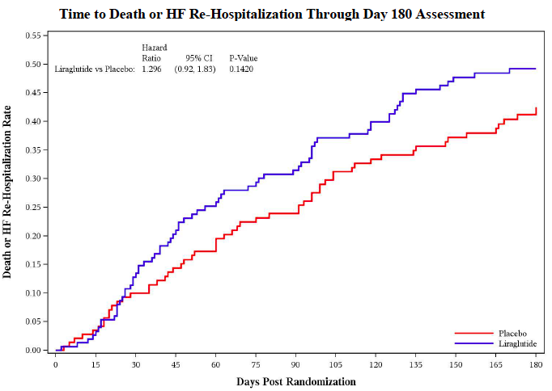
Results: Death or HF Hospitalization
0.50
0.40
0.30
0.20
0.10
0.00
Liraglutide vs. Placebo:
Hazard Ratio 95% CI P-Value
1.296 (0.92-1.83) 0.142
Death or HF Re-Hospitalization Rate
Liraglutide
Placebo
0 30 60 90 120 150 180
Days Post Randomization
Notes:
In this Kaplan-Meier analysis, the composite of death or HF hospitalization are shown for placebo-treated patients (in Red) and Liraglutide-treated patients (in Blue)
Here again, the differences between groups are non-significant, but there is a trend towards more events with liraglutide
Moreover, with the low end of the 95% confidence interval at 0.92, even this small study effectively excludes a more than 8% favorable effect on death or HF hospitalization in this advanced HF population.

Slide 13
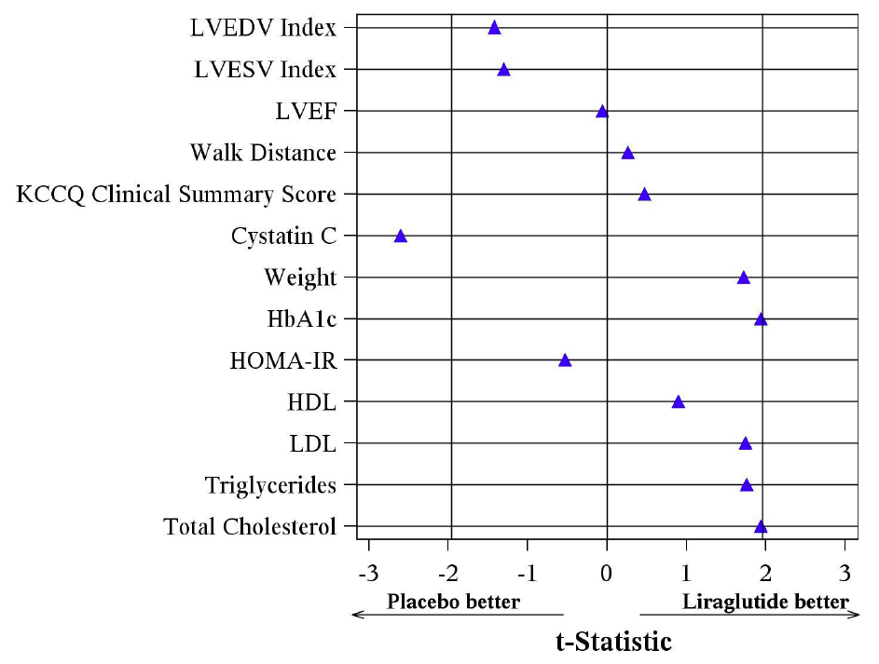
Results: Other Endpoints
All results based on changes from Baseline → 180 days
Notes:
The results for several other secondary endpoints are presented here:
Parameters of interest are shown on the left and the horizontal axis displays a global t-statistic result for each parameter such that values to the left of zero indicate a more favorable result with placebo and to the right suggest improvement with liraglutide, the vertical lines near negative 2 and positive 2 indicate statistical significance
Overall, most of these secondary endpoints fell in the middle - including the echocardiographically-derived endpoints, the 6-min walk distance and the quality of life score
The change in Cystatin C, a marker of renal dysfunction, was significantly greater in liraglutide-treated subjects suggesting some worsening of renal function in this group
On the other hand, nearly significant decreases in weight and hemoglobin A1c favored liraglutide-treated patients

Slide 14
Results: Weight Changes
Placebo Liraglutide
Diabetics
Non-Diabetics
p=.0006
p=.002
p=.076
NS
NS
NS
Δ Weight (lbs)
Δ Weight (lbs)
Day 30 Day 90 Day 180
Day 30 Day 90 Day 180
Data are changes from Baseline (mean±SEM)
Notes:
Subgroup analyses focusing on subjects with and without Diabetes were pre-specified, and this slide highlight one of these comparisons
Concerning the nearly significant overall weight change mentioned during the previous slide, segregation of diabetics and nondiabetics reveals a small but significant weight loss with liraglutide (averaging about 5 pounds) that was not observed in placebo-treated patients.
As shown on the right, this intergroup difference in Weight change was not observed among the nondiabetics.
These data, like those for glycosylated hemoglobin, demonstrate the expected biological actions of liraglutide in diabetics with advanced Heart Failure

Slide 15
Results: Safety
Adverse Event | Placebo | Liraglutide | O.R. | p-Value
Severe Hypoglycemic Event | 6% | 8% | 1.29 | 0.582
Any Hyperglycemic Event | 18% | 10% | 0.51 | 0.048
Arrhythmia | 11% | 17% | 1.65 | 0.229
Sudden Cardiac Death | 1% | 1% | 0.95 | 0.749
Acute Coronary Syndrome | 1% | 1% | 1.91 | 0.807
Worsening Heart Failure | 40% | 47% | 1.33 | 0.223
Cerebrovascular Event | 3% | 3% | 0.75 | 0.624
Venous Thromboembolism | 3% | 1% | 0.23 | 0.132
Lightheadedness, presyncope or syncope | 14% | 16% | 1.22 | 0.539
Worsened Renal Function | 10% | 18% | 1.86 | 0.073
Acute Pancreatitis | 2% | 0% |  | 0.057
Notes:
Among pre-specified safety metrics, we did not observe significant increases in severe adverse effects with liraglutide compared with placebo
There was actually a reduction in hyperglycemic events without an increase in severe hypoglycemic events
However, there was a trend towards a higher rate of worsening renal failure in the group randomized to liraglutide

Slide 16
Summary and Conclusions
The GLP-1 agonist liraglutide does not improve post-hospital clinical stability in patients with advanced HF and reduced LVEF
Among diabetics with advanced HF, liraglutide was associated with a mild reduction in weight and improved blood glucose control
Though not statistically significant, the composite of death or HF hospitalization and some renal function metrics, numerically favored placebo vs. liraglutide
Larger studies are needed to establish the safety of liraglutide or other GLP-1 agonists for diabetes management or weight loss in patients with advanced HF
Notes:
In Conclusion:
The GLP-1 agonist liraglutide does not improve post-hospitalization clinical stability in patients with relatively advanced HF and reduced LVEF
Among diabetics with advanced HF, liraglutide was associated with a mild reduction in weight and improved blood glucose control
Though not statistically significant, the composite of death or HF hospitalization, and renal function metrics numerically favored placebo vs. liraglutide
Larger studies are needed to establish the safety of liraglutide or other GLP-1 agonists for diabetes management or weight loss in patients with advanced HF, …… but these findings do not exclude the potential for beneficial effects of GLP-1 agonists in patients with earlier stages of HF

Slide 17
Heart Failure Clinical Research Network
University of Vermont Medical Center
Mayo Clinic Health System
Tufts Medical Center
Brigham and Women’s Hospital
Cleveland Clinic
Washington University
Jefferson Medical College
DCRI Coordinating Center
University of Pennsylvania
Emory University School of Medicine
Duke University School of Medicine
Regional Clinical Centers
Coordinating Center
www.hfnetwork.org
Notes:
I would like to close by acknowledging my many collaborators within the NHLBI Heart Failure Network including the Regional Clinical Centers depicted on this slide, their affiliated enrolling centers, the coordinating center at the Duke Clinical Research Institute, the NHLBI personnel and the research subjects who have all contributed significantly to this work.

